Slide 1
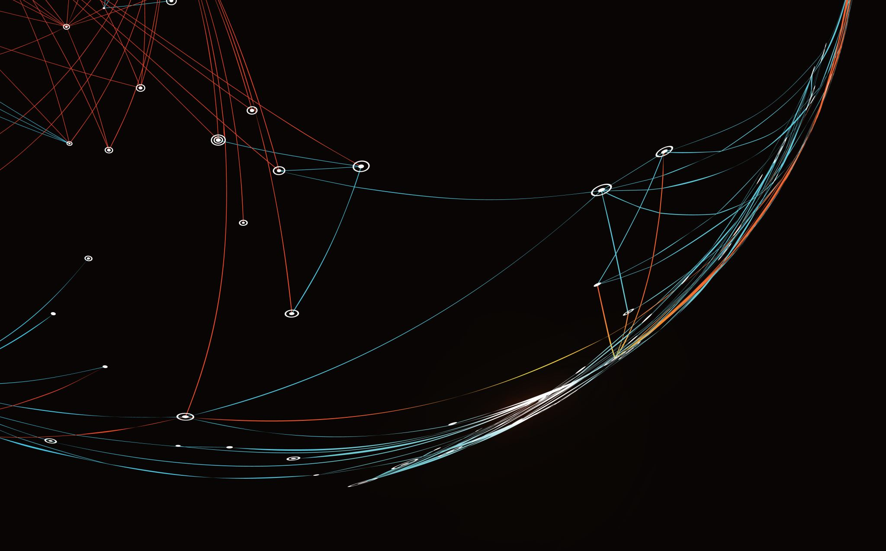
Security Assessment and Risk Management
Week 12 – Validating / Communicating Risks

Slide 2
Chicken Little Syndrome
One of the most difficult parts of the job is communicating risks.
Cybersecurity intel is a firehose. Filtering through it is a lot of work.
It’s easy for outsiders to tie the credibility of the message to the messenger.
Report out: Situational Awareness, Vulnerability Assessments
Report up: Value, loss, spending. Measurement.
Report down: Alerts. Training.

Slide 3
Incident Metrics
Intrusion attempts: How many times have bad actors tried to breach your networks?
Number of cybersecurity incidents reported: Are users reporting cybersecurity issues to your team? That’s a good sign because it means the employees and other stakeholders recognize issues. It also means your training is working.
Mean Time Between Failures (MTBF): How much time exists between system or product failures when looking to determine reliability?
Mean Time to Detect (MTTD): How long do security threats fly under the radar at your organization? MTTD measures how long it takes for your team to become aware of a potential security incident.
Mean Time to Acknowledge (MTTA): What is the average time it takes you to begin working on an issue after receiving an alert?
Mean Time to Contain (MTTC): How long does it take to contain identified attack vectors?
Mean Time to Resolve (MTTR): How long does it take your team to respond to a threat once your team is aware of it?
Mean Time to Recovery (MTTR): How long does it take your organization to recover from a product or system failure?

Slide 4
Environment Health Metrics
Unidentified devices on the internal network: Your employees bring their devices to work, and your organization may be using Internet of Things (IoT) devices that you’re unaware of. These are huge risks for your organization as these devices are probably not secure. How many of these devices are on your network?
Cybersecurity awareness training results: Who has taken (and completed) training? Did they understand the material?
Access management: How many users have administrative access?
Days to patch: How long does it take your team to implement security patches? Cybercriminals often exploit lags between patch releases and implementation.
Security Policy compliance: How well are you tracking and documenting exceptions, configurations, and compliance controls?

Slide 5
Environment Health Metrics
Non-human traffic (NHT): Are you seeing a normal amount of traffic on your website or is there an uptick that indicates a potential bot attack?
Virus infection monitoring: How often does your antivirus software scan common applications such as email clients, web browsers, and instant messaging software for known malware?
Phishing attack success: What is the percentage of phishing emails opened by end-users?
Cost per incident: How much does it cost to respond to and resolve an attack? How much money are you spending on staff overtime, investigation costs, employee productivity loss, and communication with customers?

Slide 6
Key Metrics
Security ratings.
Cybersecurity metrics examples can be measured on an easy-to-understand score card that highlights your company’s performance on some of the most common and gives each a pass/fail rating.
Often the easiest way to communicate metrics to non-technical colleagues is through an easy-to-understand score. Usually - network security, DNS health, patching cadence, endpoint security, IP reputation, web application security, hacker chatter, leaked credentials, and social engineering.

Slide 7
Key Metrics
Number of third-party vendors who have access to your network.
This is one of the it security metrics that is easy to forget; however, neglecting it can lead to dire consequences. If vendors continue to be allowed into your network long after they have completed a specified project, you leave yourself vulnerable to malicious attacks from them and from outside actors who might target your contractor’s systems.

Slide 8
Situational Awareness
• How to identify and represent mission composition and dependency relationships?
• How to derive the dependency relationships between mission elements and cyber assets?
• As a single vulnerability may enable widespread compromises in an enterprise, how to quickly identify the start point of an attack and predict its potential attack path?
• How to assess the direct impact and propagation of cyber incidents on high level mission elements and operations?
• How to systematically represent and model the identified inter- and intra- dependency relationships between major elements or components involved in cyber mission assurance?
• How to define and develop quantitative metrics and measures for meaningful cyber situational awareness, enterprise security management and mission assurance analysis?

Slide 9
Measurement for Situational Awareness
Security measurement needs to carefully consider two distinct possible issues:
How to define and use metrics as quantitative characteristics to represent the security state of a computer system or network, and
How to define and use metrics to measure CSA from a defender’s point of view.

Slide 10
Quantifying Situational Awareness
• Objective Measures: Comparing an individual’s perceptions of the situation or environment to some “ground truth” reality. This type of assessment provides a direct measure of SA and does not require operators or observers to make judgments about situational knowledge on the basis of incomplete information. Generally, objective measures can be gathered in three ways:
in real-time as the task is completed,
during an interruption in task performance, or
post-test following completion of the task.

Slide 11
Quantifying Situational Awareness
• Subjective Measures: Asking individuals to rate their own or the observed SA of individuals on an anchored scale.
Subjective measures of SA are relatively straightforward and easy to administer, but they also suffer from several limitations. For example, individuals are often unaware of information they do not know, and they cannot fully exploit the multivariate nature of SA to provide detailed diagnostics.

Slide 12
Quantifying Situational Awareness
Performance Measures: Assuming that better performance usually indicates better SA, performance measures infer SA from performance outcomes.
Commonly used performance metrics, including the quantity of output or productivity level, time to perform the task or respond to an event, the accuracy of the response, and the number of errors committed.
Good SA does not always lead to good performance, and poor SA does not always lead to poor performance. Performance measures should be used in conjunction with others measures for more accurate assessment.

Slide 13
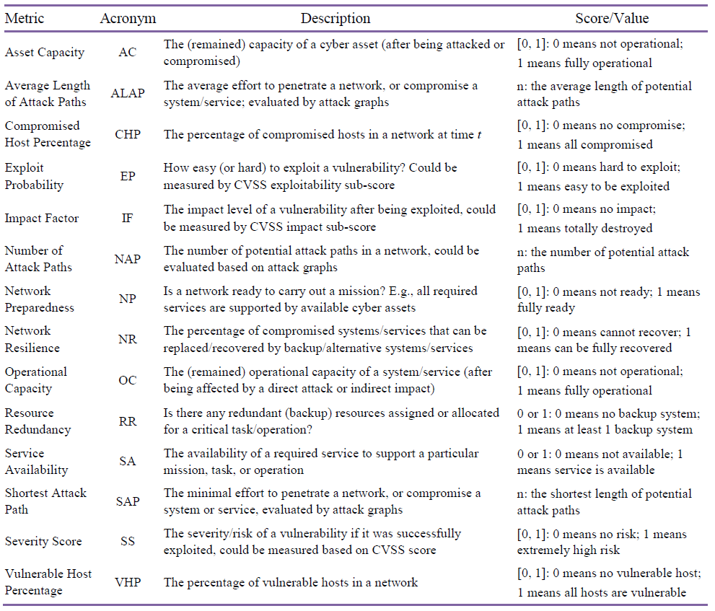

Slide 14
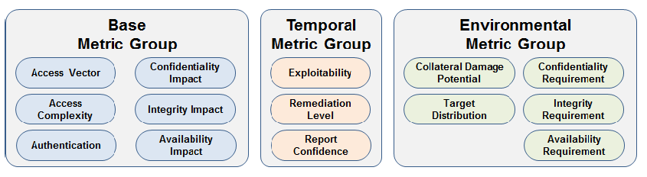
CVSS Metric Groups
https://www.first.org/cvss/v2/guide

Slide 15
Quantifying Situational Awareness
Behavioral Measures: Based on the assumption that good actions usually follow from good SA and vice-versa, behavioral measures infer SA from individuals’ actions.
Behavioral measures are subjective in nature, as they primarily rely on observer ratings.

Slide 16
When CSA is Failing
• Lack of real-time CSA
• Lack of understanding of impacts of cyber events on high level mission operations
• Lack of quantitative metrics and measures for comprehensive security assessment
• Lack of incorporating human (analyst) cognition into cyber-physical situational awareness
• Lack of mission assurance policy

Slide 17
National Vulnerability Database
https://nvd.nist.gov/

Slide 18
To evaluate the general security of an enterprise network based on vulnerability assessment, we use three security metrics:
The vulnerable host percentage (VHP)
CVSS severity score
Compromised host percentage (CHP).

Slide 19

The Vulnerable Host Percentage (VHP)
This metric represents the overall security level of a network. The number of vulnerable hosts can be obtained by periodically scanning a network via vulnerability scanning tools such as Nessus. The equation for this metric is given below, where G represents an intended network, V is the set of vulnerable hosts, and H is the set of all hosts in the network.

Slide 20
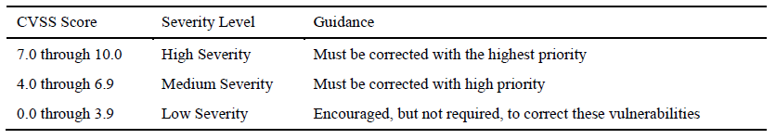
Severity Score of a single vulnerability (SSi)
After identifying vulnerabilities that exist in a network, we need to know the severity score of each identified vulnerability based on CVSS. As shown in the table, this metric indicates the severity of certain vulnerability, and how to handle it accordingly.

Slide 21

Compromised Host Percentage (CHP)
This metric indicates the percentage of hosts that have been compromised in a network. Here, a host compromise is defined as the attacker having obtained the user- or administrator- level privilege on the intended host. Higher CHP value means more hosts are compromised. The equation for this metric is given below, where G represents an intended network, C is the set of compromised hosts, and H is the set of all hosts in the network

Slide 22
Damage Assessment
1) Attack Start Point Detection: The first step is to identify the start point of an attack. Currently, we use leaf nodes in our attack graphs as the start points.
2) Direct Impact Assessment: The next step is to determine the direct impact of an attack on the targeted asset. We calculate the direct impact based on CVSS.
3) Propagation of Cyber Impacts through the Network: In this step, we calculate the potential impacts on cyber capacities of all mission-related assets along the attack paths derived from our attack graphs
4) Mission Impact Assessment: After knowing the current capacities of all assets involved in a mission, we can further calculate the potential impacts on the high level missions based on mission asset dependency relationships derived by our logical mission models.

Slide 23
Impact and Mission Relevance Analysis
To efficiently represent and model the dependency relationships between high level mission elements and the underlying computer network and cyber assets, a Logical Mission Model (LMM) is developed in our framework. Essentially, the LMM is a hierarchical graphical model for mission planning, decomposition, modeling, and asset mapping, which is further composed of a Value-based Goal Model (VGM) and a Logical Role Model (LRM).

Slide 24
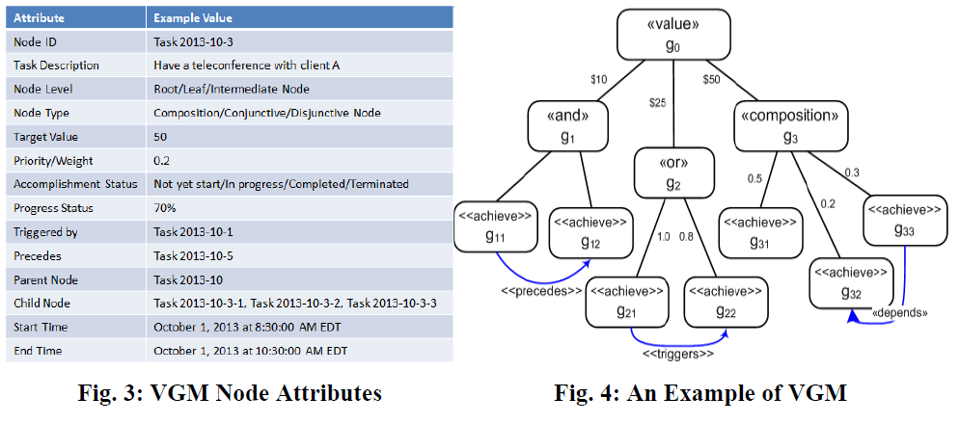
VGM Nodes and Attributes

Slide 25
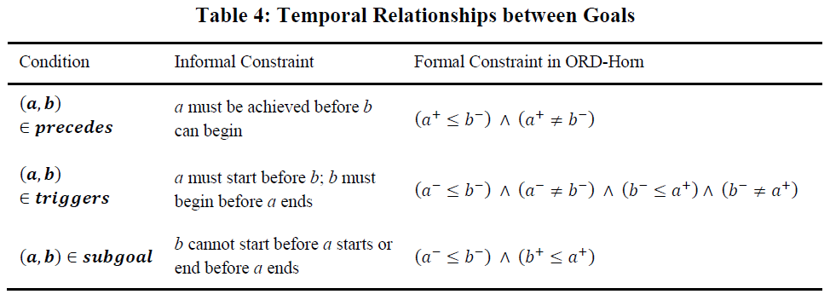
Temporal Relationships

Slide 26
Direct Impact of Cyber Incidents
The direct impact can be defined as the loss of the Asset Capacity (AC) of an asset that is a direct target of an attack.
As an internal feature of an asset, AC stays unchanged for the asset until its value is adjusted by external (human) operations (e.g., network operators may reset AC to 1 by recovering the damaged system).
The initial value of AC is 1 is assumed for each asset – aka. It is fully operational before it was attacked.

Slide 27
History of Cybercrime 1960s
Before computers became prevalent, “hacking” was a term students at MIT used when they figured out ways to get their model trains to do things they weren’t originally intended to do. It became a term that meant “applying ingenuity to create a clever result.”
Some of these model train enthusiasts went on to work on some of the very first computing projects, and the term carried over with them. A lot of work in those days was on the cutting edge, and they often found they had to “hack together” a solution to an unexpected problem.

Slide 28
History of Cybercrime 1970s
The term “hacking” becomes associated with malicious intent thanks to a handful of individuals exploiting these new systems.
Phone phreaking – In the old days of landlines and long distance, some people figured out you could manipulate the phone system for free calls. By reproducing tones (blue boxing), and digging through phone company trash to find secrets, they learned to exploit the system.
One phreak, John Draper (aka "Cap'n Crunch"), learned that a toy whistle given away inside Cap'n Crunch cereal generates a 2600-hertz signal, the same high-pitched tone that accesses AT&T's long-distance switching system. Draper builds a "blue box" that, when used in conjunction with the whistle and sounded into a phone receiver, allows phreaks to make free calls.
Shortly thereafter, Esquire magazine publishes "Secrets of the Little Blue Box" with instructions for making a blue box, and wire fraud in the United States escalates. Among the perpetrators: college kids Steve Wozniak and Steve Jobs, future founders of Apple Computer, who launch a home industry making and selling blue boxes.
Crimes were mostly petty or pranks – just hobbyists exploring systems.

Slide 29
History of Cybercrime 1980s
Phone phreaks begin to move into the realm of computer hacking, and the first electronic bulletin board systems (BBSs) spring up.
The precursor to Usenet newsgroups and e-mail, the boards -- with names such as "Sherwood Forest" and "Catch-22" -- become the venue of choice for phreaks and hackers to gossip, trade tips, and share stolen computer passwords and credit card numbers.
Hacking groups begin to form. Among the first are Legion of Doom in the United States, and Chaos Computer Club in Germany.
The movie "War Games" introduces the public to hacking, and the legend of hackers as cyberheroes (and anti-heroes) is born. The film's main character, played by Matthew Broderick, attempts to crack into a video game manufacturer's computer to play a game, but instead breaks into the military's nuclear combat simulator computer.
The computer (codenamed WOPR, a pun on the military's real system called BURGR) misinterprets the hacker's request to play Global Thermonuclear War as an enemy missile launch. The break-in throws the military into high alert, or Def Con 1 (Defense Condition 1).

Slide 30
History of Cybercrime 1980s
1983 (same year as War Games), authorities arrest six teenagers known as the 414 gang (after the area code to which they are traced). During a nine-day spree, the gang breaks into some 60 computers, among them computers at the Los Alamos National Laboratory, which helps develop nuclear weapons.
The hacker magazine 2600 begins regular publication, followed a year later by the online 'zine Phrack. The editor of 2600, "Emmanuel Goldstein" (whose real name is Eric Corley), takes his handle from the main character in George Orwell's "1984." Both publications provide tips for would-be hackers and phone phreaks, as well as commentary on the hacker issues of the day. Today, copies of 2600 are sold at most large retail bookstores.

Slide 31
History of Cybercrime 1980s
1986: Use a Computer, Go to Jail
In the wake of an increasing number of break-ins to government and corporate computers, Congress passes the Computer Fraud and Abuse Act, which makes it a crime to break into computer systems. The law, however, does not cover juveniles.
1988: The Morris Worm
Robert T. Morris, Jr., a graduate student at Cornell University and son of a chief scientist at a division of the National Security Agency, launches a self-replicating worm on the government's ARPAnet (precursor to the Internet) to test its effect on UNIX systems.
The worm gets out of hand and spreads to some 6,000 networked computers, clogging government and university systems. Morris is dismissed from Cornell, sentenced to three years' probation and fined $10,000.

Slide 32
History of Cybercrime 1980s
1989: The Germans and the KGB
In the first cyberespionage case to make international headlines, hackers in West Germany (loosely affiliated with the Chaos Computer Club) are arrested for breaking into U.S. government and corporate computers and selling operating-system source code to the Soviet KGB. Three of them are turned in by two fellow hacker spies, and a fourth suspected hacker commits suicide when his possible role in the plan is publicized. Because the information stolen is not classified, the hackers are fined and sentenced to probation.
In a separate incident, a hacker is arrested who calls himself "The Mentor." He publishes a now-famous treatise that comes to be known as the Hacker's Manifesto. The piece, a defense of hacker antics, begins, "My crime is that of curiosity ... I am a hacker, and this is my manifesto. You may stop this individual, but you can't stop us all."

Slide 33
History of Cybercrime 1990s
1990: Operation Sundevil
After a prolonged sting investigation, Secret Service agents swoop down on hackers in 14 U.S. cities, conducting early-morning raids and arrests.
The arrests involve organizers and prominent members of BBSs and are aimed at cracking down on credit-card theft and telephone and wire fraud. The result is a breakdown in the hacking community, with members informing on each other in exchange for immunity.
1993: Why Buy a Car When You Can Hack One?
During radio station call-in contests, hacker-fugitive Kevin Poulsen and two friends rig the stations' phone systems to let only their calls through, and "win" two Porsches, vacation trips and $20,000.
Poulsen, already wanted for breaking into phone-company systems, serves five years in prison for computer and wire fraud. (Since his release in 1996, he has worked as a freelance journalist covering computer crime.)
The first Def Con hacking conference takes place in Las Vegas. The conference is meant to be a one-time party to say good-bye to BBSs (now replaced by the Web), but the gathering is so popular it becomes an annual event.

Slide 34
History of Cybercrime 1990s
1994: Hacking Tools R Us
The Internet begins to take off as a new browser, Netscape Navigator, makes information on the Web more accessible. Hackers take to the new venue quickly, moving all their how-to information and hacking programs from the old BBSs to new hacker Web sites.
As information and easy-to-use tools become available to anyone with Net access, the face of hacking begins to change.

Slide 35
History of Cybercrime 1990s
1995: The Mitnick Takedown
Serial cybertrespasser Kevin Mitnick is captured by federal agents and charged with stealing 20,000 credit card numbers. He's kept in prison for four years without a trial and becomes a celebrity in the hacking underground.
After pleading guilty to seven charges at his trial in March 1999, he's eventually sentenced to little more than time he had already served while he wait for a trial.
Russian crackers siphon $10 million from Citibank and transfer the money to bank accounts around the world. Vladimir Levin, the 30-year-old ringleader, uses his work laptop after hours to transfer the funds to accounts in Finland and Israel.
Levin stands trial in the United States and is sentenced to three years in prison. Authorities recover all but $400,000 of the stolen money.
1997: Hacking AOL
AOHell is released, a freeware application that allows a burgeoning community of unskilled hackers -- or script kiddies -- to wreak havoc on America Online (AOL). For days, hundreds of thousands of AOL users find their mailboxes flooded with multi-megabyte mail bombs and their chat rooms disrupted with spam messages. (AOL Time Warner is the parent company of CNN.com.)

Slide 36
History of Cybercrime 1990s
1998: The Cult of Hacking and the Israeli Connection
The hacking group Cult of the Dead Cow releases its Trojan horse program, Back Orifice -- a powerful hacking tool -- at Def Con. Once a hacker installs the Trojan horse on a machine running Windows 95 or Windows 98, the program allows unauthorized remote access of the machine.
During heightened tensions in the Persian Gulf, hackers touch off a string of break-ins to unclassified Pentagon computers and steal software programs. Then-U.S. Deputy Defense Secretary John Hamre calls it "the most organized and systematic attack" on U.S. military systems to date.
An investigation points to two American teens. A 19-year-old Israeli hacker who calls himself "The Analyzer" (aka Ehud Tenebaum) is eventually identified as their ringleader and arrested. Today Tenebaum is chief technology officer of a computer consulting firm.
1999: Software Security Goes Mainstream
In the wake of Microsoft's Windows 98 release, 1999 becomes a banner year for security (and hacking). Hundreds of advisories and patches are released in response to newfound (and widely publicized) bugs in Windows and other commercial software products. A host of security software vendors release anti-hacking products for use on home computers.

Slide 37
History of Cybercrime 2000s
2000: Service Denied
In one of the biggest denial-of-service attacks to date, hackers launch attacks against eBay, Yahoo!, CNN.com., Amazon and others.
Activists in Pakistan and the Middle East deface Web sites belonging to the Indian and Israeli governments to protest oppression in Kashmir and Palestine.
Hackers break into Microsoft's corporate network and access source code for the latest versions of Windows and Office.
2001: DNS Attack
Microsoft becomes the prominent victim of a new type of hack that attacks the domain name server. In these denial-of-service attacks, the DNS paths that take users to Microsoft's Web sites are corrupted. The hack is detected within a few hours, but prevents millions of users from reaching Microsoft Web pages for two days.
July: Russian programmer Dmitry Sklyarov is arrested at the annual Def Con hacker convention. He was the first person criminally charged with violating the Digital Millennium Copyright Act (DMCA).
August: Code Red worm, infects tens of thousands of machines.

Slide 38
History of Cybercrime 2000s
2002: Security hits the mainstream
January: Bill Gates decrees that Microsoft will secure its products and services, and kicks off a massive internal training and quality control campaign.
May: Klez.H, a variant of the worm discovered in November 2001, becomes the biggest malware outbreak in terms of machines infected, but causes little monetary damage.
June: The Bush administration files a bill to create the Department of Homeland Security, which, among other things, will be responsible for protecting the nation's critical IT infrastructure.
August: Researcher Chris Paget publishes a paper describing "shatter attacks", detailing how Windows‘ unauthenticated messaging system can be used to take over a machine. The paper raises questions about how securable Windows could ever be. It is however largely derided as irrelevant as the vulnerabilities it described are caused by vulnerable applications (placing windows on the desktop with inappropriate privileges) rather than an inherent flaw within the Operating System.

Slide 39
History of Cybercrime 2000s
2003: Everyone’s a hacker
The hacktivist group Anonymous was formed.
March: Cult of the Dead Cow and Hacktivismo are given permission by the United States Department of Commerce to export software utilizing strong encryption.
2004: State-sponsored mayhem
July: North Korea claims to have trained 500 hackers who successfully crack South Korean, Japanese, and their allies' computer systems.
2005: The hammer comes down
April 2: Rafael Núñez (aka RaFa), a notorious member of the hacking group World of Hell, is arrested following his arrival at Miami International Airport for breaking into the Defense Information Systems Agency computer system on June 2001.
September 13: Cameron Lacroix is sentenced to 11 months for gaining access to T-Mobile's network and exploiting Paris Hilton's Sidekick.
November 3: Jeanson James Ancheta, whom prosecutors say was a member of the "Botmaster Underground", a group of script kiddies mostly noted for their excessive use of bot attacks and propagating vast amounts of spam, was taken into custody after being lured to FBI offices in Los Angeles.

Slide 40
History of Cybercrime 2000s
2006: What’s old is new again
January: One of the few worms to take after the old form of malware, destruction of data rather than the accumulation of zombie networks to launch attacks from, is discovered. It had various names, including Kama Sutra (used by most media reports). It would hit a web page counter when it took control, allowing the programmer who created it as well as the world to track the progress of the worm.
May: Jeanson James Ancheta receives a 57-month prison sentence, and is ordered to pay damages amounting to $15,000.00 to the Naval Air Warfare Center in China Lake and the Defense Information Systems Agency, for damage done due to DDoS attacks and hacking. Ancheta also had to forfeit his gains to the government, which include $60,000 in cash, a BMW, and computer equipment.
May: The largest defacement in Web History as of that time is performed by the Turkish hacker iSKORPiTX who successfully hacked 21,549 websites in one shot.
July: Robert Moore and Edwin Pena featured on America's Most Wanted with Kevin Mitnick presenting their case commit the first VoIP crime ever seen in the USA. Robert Moore served 2 years in federal prison with a $152,000.00 restitution while Edwin Pena was sentenced to 10 years and a $1 million restitution.

Slide 41
History of Cybercrime 2000s
2007: Nothing safe
May 17: Estonia recovers from massive denial-of-service attack
June 13: FBI Operation Bot Roast finds over 1 million botnet victims
June 21: A spear phishing incident at the Office of the Secretary of Defense steals sensitive U.S. defense information, leading to significant changes in identity and message-source verification at OSD.
August 11: United Nations website hacked by Turkish Hacker Kerem125.
2008
January 17: Project Chanology; Anonymous attacks Scientology website servers around the world. Private documents are stolen from Scientology computers and distributed over the Internet.
March 7: Around 20 Chinese hackers claim to have gained access to the world's most sensitive sites, including The Pentagon. They operated from an apartment on a Chinese Island.
March 14: Trend Micro website successfully hacked by Turkish hacker Janizary (aka Utku).

Slide 42
History of Cybercrime 2010s
2010
January 12: Operation Aurora Google publicly reveals that it has been on the receiving end of a "highly sophisticated and targeted attack on our corporate infrastructure originating from China that resulted in the theft of intellectual property from Google"
June: Stuxnet The Stuxnet worm is found by VirusBlokAda. Stuxnet was unusual in that while it spread via Windows computers, its payload targeted just one specific model and type of SCADA systems. It slowly became clear that it was a cyber attack on Iran's nuclear facilities - with most experts believing that Israel was behind it - perhaps with US help.

Slide 43
History of Cybercrime 2010s
2011
The hacker group Lulz Security is formed.
April 9: Bank of America website got hacked by a Turkish hacker named JeOPaRDY. An estimated 85,000 credit card numbers and accounts were reported to have been stolen due to the hack. Bank officials say no personal customer bank information is available on that web-page. Investigations are being conducted by the FBI to trace down the incriminated hacker.
April 17: An "external intrusion" sends the PlayStation Network offline, and compromises personally identifying information (possibly including credit card details) of its 77 million accounts, in what is claimed to be one of the five largest data breaches ever.
Computer hacker sl1nk releases information of his penetration in the servers of the Department of Defense (DoD), Pentagon, NASA, NSA, US Military, Department of the Navy, Space and Naval Warfare System Command and other UK/US government websites.
September: Bangladeshi hacker TiGER-M@TE made a world record in defacement history by hacking 700,000 websites in a single shot.

Slide 44
History of Cybercrime 2010s
2012
June 5: The social networking website LinkedIn has been hacked and the passwords for nearly 6.5 million user accounts are stolen by cybercriminals. As a result, a United States grand jury indicted Nikulin and three unnamed co-conspirators on charges of aggravated identity theft and computer intrusion.
August 15: The most valuable company in the world Saudi Aramco is crippled by a cyber warfare attack for months by malware called Shamoon. Considered the biggest hack in history in terms of cost and destructiveness . Carried out by an Iranian attacker group called Cutting Sword of Justice. Iranian hackers retaliated against Stuxnet by releasing Shamoon. The malware destroyed over 35,000 Saudi Aramco computers, affecting business operations for months.
December 17: Computer hacker sl1nk announced that he has hacked a total of 9 countries' SCADA systems. The proof includes 6 countries: France, Norway, Russia, Spain, Sweden and the United States.

Slide 45
History of Cybercrime 2010s
2013
The social networking website Tumblr is attacked by hackers. Consequently, 65,469,298 unique emails and passwords were leaked from Tumblr. The data breach's legitimacy is confirmed by computer security researcher Troy Hunt.
2014
October: The White House computer system was hacked. It was said that the FBI, the Secret Service, and other U.S. intelligence agencies categorized the attacks "among the most sophisticated attacks ever launched against U.S. government systems."
November 24: In response to the release of the film The Interview, the servers of Sony Pictures are hacked by a hacker group calling itself "Guardian of Peace".

Slide 46
History of Cybercrime 2010s
2015
June: the records of 21.5 million people, including social security numbers, dates of birth, addresses, fingerprints, and security-clearance-related information, are stolen from the United States Office of Personnel Management. Most of the victims are employees of the United States government and unsuccessful applicants to it. The Wall Street Journal and the Washington Post report that government sources believe the hacker is the government of China.
July: The servers of extramaritial affairs website Ashley Madison were breached.
2016
July 22: Wikileaks published the documents from the 2016 Democratic National Committee email leak.
July 29: a group suspected coming from China launched hacker attacks on the website of Vietnam Airlines.
September: Hacker Ardit Ferizi is sentenced to 20 years in prison after being arrested for hacking U.S. servers and passing the leaked information to members of ISIL terrorist group back in 2015.
October: The 2016 Dyn cyberattack is being conducted with a botnet consisting of IOTs infected with Mirai by the hacktivist groups SpainSquad, Anonymous, and New World Hackers, reportedly in retaliation for Ecuador's rescinding Internet access to WikiLeaks founder Julian Assange at their embassy in London, where he has been granted asylum.

Slide 47
History of Cybercrime 2010s
2017
April: A hacker group calling itself "The Dark Overlord" posted unreleased episodes of Orange Is the New Black TV series online after they failed to extort online entertainment company Netflix.
May: WannaCry ransomware attack started on Friday, 12 May 2017, and has been described as unprecedented in scale, infecting more than 230,000 computers in over 150 countries.
May: 25,000 digital photos and ID scans relating to patients of the Grozio Chirurgija cosmetic surgery clinic in Lithuania were obtained and published without consent by an unknown group demanding ransoms. Thousands of clients from more than 60 countries were affected. The breach turned attention to weaknesses in Lithuania's information security.
June: 2017 Petya cyberattack.
May–July 2017: The Equifax breach.

Slide 48
Bottom Line: Names to Know
Chaos Computer Club
One of the few groups with any sort of moral code. It also is probably the oldest- it was founded by a small group of Germans in 1981.
Not only have they survived, but they've been accepted, recognized, and sometimes glorified by the press.
CCC gained notoriety in the 80's when they notified the Deutsche Bundespost of flaws in their online system. Deutsche Bundespost was somewhat of an ideal target for an early hacktivist group, because they actively tried to keep more technologically advanced startups from competing. Deutsche Bundespost's system provider responded by assuring everyone that the system was secure. Of course, CCC still hacked the system and stole DM 134,000. They returned the money the next day.

Slide 49
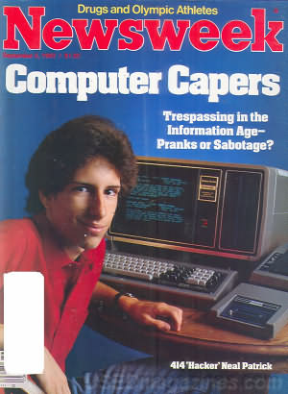
Bottom Line: Names to Know
The 414s
One of the original hacking groups in the 1980s. A group of kids 16-22 that met through Explorer Scouts and took their name form the area code of Milwaukee, WI.
They used inexpensive personal computers, analog modems, and simple hacking techniques, such as using common or default passwords published in DEC's manufacturer guides to log in to various timeshare systems. The 414s were exploiting the lack of administrative oversight and password care for systems and not the technology at the time.
Among those reporting unusual hacking activities was Chen Chui, an administrator who discovered an electronic break-in, left a message for the intruders, and contacted the FBI, who placed wiretaps and eventually traced the calls back to Milwaukee. Gerald Wondra, 22 at the time, was the first visited by the FBI. Wondra lived with his mother in West Allis, a Milwaukee suburb. Wondra said he was "curious, he was just having fun".

Slide 50
Bottom Line: Names to Know
Anonymous
A “hacktivist group” identified in public by wearing a Guy Fawkes Masks. Anons, as they are widely known, have publicized themselves by attacking the government, religious and corporate websites. The Vatican, the FBI, the CIA, PayPal, Sony, Mastercard, Visa, Chinese, Israeli, Tunisian, and Ugandan governments have been amongst their targets.
Since they are a largely decentralized loose collective, they have no real statement or mission, and their target tends to be whatever happens to rile them up at any given moment. However, many of the group members have clarified their intent to attack internet censorship and control.
"Anon" as a name comes from the anonymous image boards (4chan, 8chan, overchan, anon-ib, etc.) where posters do not subscribe with a user account, but posts there are rather posted as "Anonymous"

Slide 51
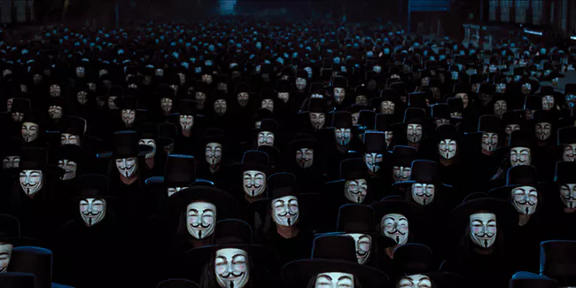
Anonymous Symbolism
Anonymous is identified by the Guy Fawkes mask. The media has made a lot out of this symbol, but the truth is that it is fruitless to search for deeper meaning with a group like this. If you want to understand why they use this symbol, watch the movie "V for Vendetta" (do not read the graphic novel – most members of Anonymous aren't even aware it exists.)

Slide 52
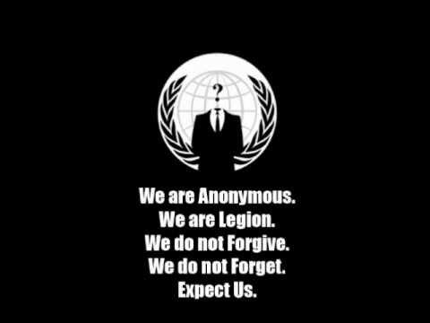
Anonymous Symbolism
They are also identified by the empty suit and the motto "We do not forgive. We do not forget. Expect us." Or similar symbolism. The intent is intimidation. The implication is that Anonymous could be (or is) everyone, anyone, anywhere.
Another popular quote is paraphrased from Palahniuk's Fight Club: "Remember this. The people you're trying to step on, we're everyone you depend on. We're the people who do your laundry and cook your food and serve your dinner. We make your bed. We guard you while you're asleep. We drive the ambulances. We direct your call. We are cooks and taxi drivers and we know everything about you. We process your insurance claims and credit card charges. We control every part of your life."

Slide 53
Anonymous' Goals
Given that they are a loose affiliation of individuals, their targets require something to galvanize their efforts. This means a single (or group of) charismatic individuals with a cause for the collective to rally behind.
This leaves things fairly open. Some targets might be chosen due to outrage (individualized group-think moral panic) or "for the lulz."
By 2017, they now boast over 300 operations of varying success, but with no clear agenda or mission. Their list of ops seems apolitical (or with no clear affiliation) - though a pattern emerges that they detest weakness (defined as both "degeneracy" as well as disability) and anything that limits their access to free expression. It is, for better or worse and in the absence of a better alternative, the apparent conscience of the Internet.

Slide 54
Bottom Line: Names to Know
LulzSec
LulzSec or Lulz Security, was a high profile, Black Hat hacker group. They gained credentials for hacking into Sony, News International, CIA, FBI, Scotland Yard, and several noteworthy accounts. While the group claims to have retired, the motto of the group, “Laughing at your security since 2011!” stays alive. There are assertions of the group having hacked into the websites of the newspapers like The Times and The Sun to post its retirement news. Many, however, claim that this group had taken it upon itself to create awareness about the absence of efficient security against hackers.
Since retired, and have had several members of the group exposed and prosecuted.

Slide 55

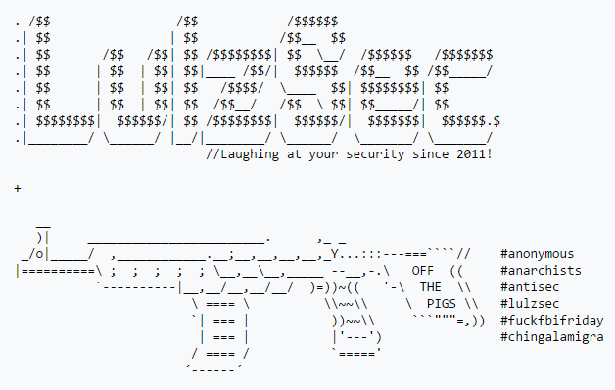
LulzSec Symbolism

Slide 56
Bottom Line: Names to Know
The Syrian Electronic Army
The Syrian Electronic Army (SEA) is a hacker group with Syrian sympathies as well as connections to Iran and Hezbollah. They've shown a wide array of attack capabilities. Most famously, they've defaced many major Western news outlets, but they have also managed to locate opposition rebels using malware. Also, if you're a fan of The Onion, you should read the Onion's response to a SEA hack.
The SEA is unique because of its varied tone and style. For example, it tweeted from AP's account that Obama had been injured in explosions at the White House. This one simple tweet sparked a dramatic temporary fall in the DOW Jones Index. On the lighter side, they've tweeted from BBC Weather that "Saudi weather station down due to head on-collision with camel". Their familiarity with English colloquialism and humor raises questions about the SEA's identity, but the NYT has stated that the SEA is probably Iranian.

Slide 57
Bottom Line: Names to Know
Bureau 121
Although most technology in North Korea is extremely outdated, their government still has shown interest in hacking. According to defectors, military hackers live extravagant lives in North Korea. Top students are handpicked from straight out of their "University of Automation" school. The primary wing of this hacking group is known as Bureau 121. It comprises about 1,800 people that work around the world (because internet infrastructure in NK is pretty terrible).
Most of the Bureau's activity has been focused on South Korea. Attacks have ranged from malicious gaming apps targeted at South Korea, hacking the website of the South Korean President, and destroying data of banks and broadcasting companies. Guardians of Peace, the group behind the famous Sony hack might have been a Bureau 121 proxy. That particular hack cost Sony about $15 million.

Slide 58
Bottom Line: Names to Know
Chinese APTs
Elderwood Group, Axiom, Unit 61398, Comment Crew, Putter Panda, Hidden Lynx, and many more. China pioneered the state-sponsored hacking group, and they've continued to perfect the practice.
One of the more famous attacks came in 2010 under the name "Operation Aurora". We in part know about Operation Aurora because Google came forward and announced it had been hacked.

Slide 59
Bottom Line: Names to Know
Dragonfly
Another likely state-sponsored group, this time out of Eastern Europe and Russia, is Dragonfly. Dragonfly is likely state-sponsored due to its targets: electric grids, energy industry, and other control systems in U.S. and Europe.
Their most common attacks are spear-phishing and watering hole attacks. This is not unusual for APT groups. They've also demonstrated capabilities to embed trojans in legitimate software for industrial control systems. This is very reminiscent Stuxnet. When Stuxnet was first found, it was recognized to be universal for many industries. It might be that we are starting to see Stuxnet-like worm capabilities for organizations other than the United States and Israel.

Slide 60
Bottom Line: Names to Know
Tailored Access Operations (NSA)
If it weren't for Edward Snowden, we probably wouldn't know about Tailored Access Operations (TAO). TAO has some of the best capabilities in the world, and has collected about all the American telephone data you can imagine. Once revealed, more and more details have come out about them.
They have sophisticated unique abilities that are difficult to even dream up. One of those capabilities is QUANTUMSQUIRREL, which allows them to appear on the internet anywhere as anyone. They've also compromised very common computer systems often with physical access or cooperation with network or hardware companies. They are known to force companies to insert vulnerabilities into their own systems for TAO to exploit.
Just about all the details of the organization are Orwellian. Take, for example, WARRIOR PRIDE. It's IPhone and Android software that can turn on a phone remotely, turn the microphone of the phone on and listen, track using geolocation, and its own tamper-proofing and stealth programming. That's just one that we know about.

Slide 61
Intel Sources: Official Sources
https://www.cisa.gov/uscert/ncas/alerts
https://www.fireeye.com/company/fireeye-cyber-attack-alert-subscription.html
https://www.nsa.gov/Press-Room/Cybersecurity-Advisories-Guidance/
https://www.fbi.gov/investigate/cyber/news
Regular reports: https://www.ic3.gov/, VDBIR, etc

Slide 62
Intel Sources: Technical
https://rhinosecuritylabs.com/blog/
https://revers.engineering/
https://googleprojectzero.blogspot.com/
https://a13xp0p0v.github.io/ (ru, partly)

Slide 63
Intel Sources: News
https://thehackernews.com/
https://www.infosecurity-magazine.com/
https://www.itsecurityguru.org/
https://www.schneier.com/
https://krebsonsecurity.com/
https://www.darkreading.com/
https://threatpost.com/
WIRED, Ars Technica, etc

Slide 64
Intel Sources: Social Media
r/cybersecurity
r/netsec
Twitter – Follow accounts that post blue team stuff, but also follow accounts used as mouthpieces for groups.
YT: LiveOverflow, John Hammond, Cyber Mentor, ScriptKid, PC Security Channel, Computerphile, NetworkChuck, PwnFunction
Watch Cons: DefCon, Blackhat, RSA, GrrCON, Bsides, Wild West Hackin Fest, CyCon

Slide 65
Intel Sources: Unofficial Sources
RaidForums -> Breached.co
HacKForums
BHF.io (ru)
8Chan, EndChan (/os/), Dread (/d/OpSec, Recon), InfoCon, etc.

